Slide 1
MATH1123
Calculus for Science and Engineering

Slide 2
Instructor: Dr. Min ZHOU
Office: T6-302-R2
Tel: 3620438(Instructor)
Email: minzhou@uic.edu.cn (Instructor)
T.A.: Mr. Likang Li
Office: V26-202
Email: lilikang@uic.edu.cn

Slide 3
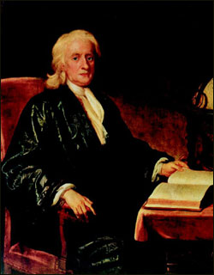
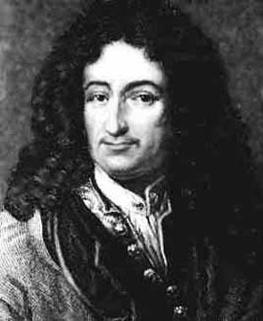
They invented Calculus!
Sir Isaac Newton (1642-1727)
Gottfriend Wilhelm von Leibniz
(1646-1716)

Slide 4
What is Calculus all about?
Calculus is the study of change, or to be more precise, changing quantities.
The two key areas of Calculus are Differential Calculus and Integral Calculus.
The big surprise is that these two seemingly unrelated areas are actually connected via the Fundamental Theorem of Calculus.

Slide 5
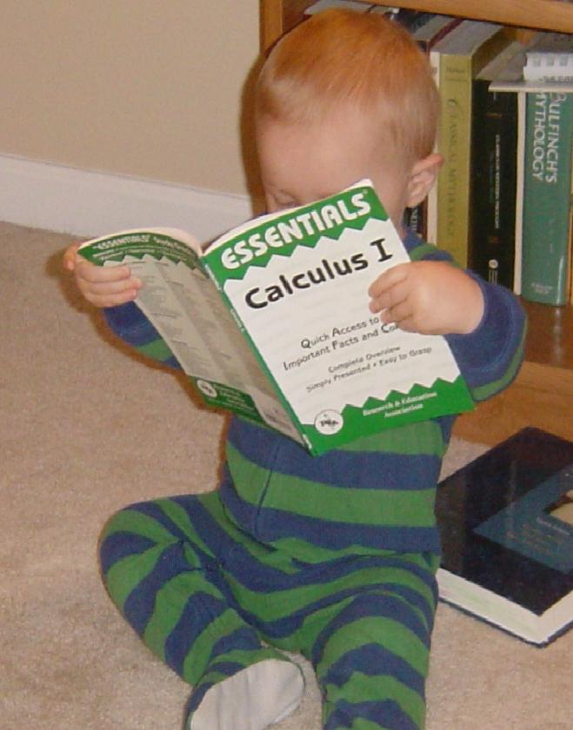
Why do I have to take Calculus?
If you choose a career path that requires any level of mathematical sophistication (such as Engineering, Economics or any branch of Science), you will need Calculus.
To succeed in Calculus (and Mathematics in general) you must be able to: solve problems, reason logically and understand abstract concepts. The ability to master these skills is a key indicators of success in future academic endeavors.

Slide 6
What can I do to maximize my chances for success?
Top five
Understand, don't memorize.
Ask why, not how.
More practices and exercises.
Learn techniques, not results.
Make sure you understand each topic before going on to the next.

Slide 7
Some Suggestions
Bring your questions when you take lecture. Questions could be found by preview.
Review what you have studied as soon as possible after lecture. Textbook should be read carefully.
Try your best to attend all lectures and tutorial class.

Slide 8
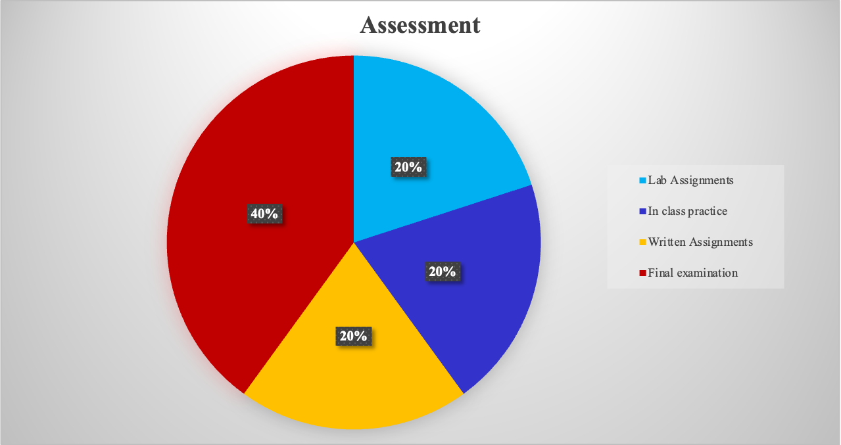
Assessment

Slide 9
CRA (Criterion-Referenced Assessment)
Adoption of the Criterion-Referenced Assessment (CRA) for evaluating students’ performance
OBTL Syllabus
CRA model is directly compatible with the OBTL philosophy.

Slide 10
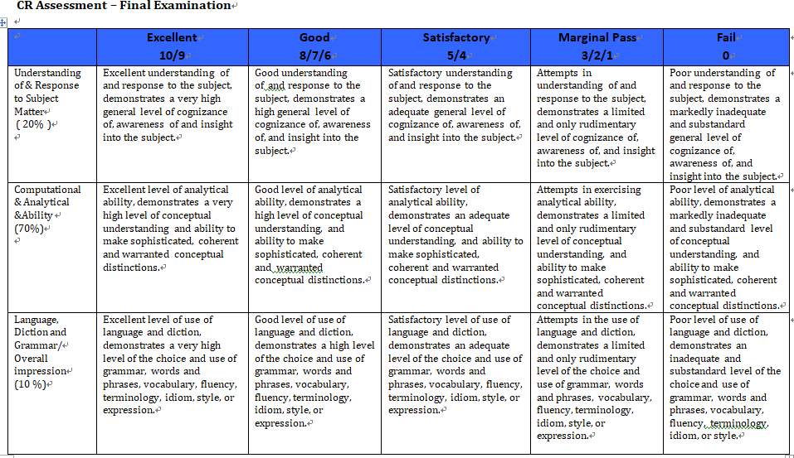

Slide 11
Score System
Letter Grade | Academic Performance
A | Excellent
A- | Excellent
B+ | Good
B | Good
B- | Good
C+ | Satisfactory
C | Satisfactory
C-
D | Marginal Pass
F | Fail

Slide 12
Some notices on this Course
Assignments must be handed in before the deadline. After the deadline, we refuse to accept your assignments!
For the mid-term test and final examination, you can
not bring anything except some stationeries and water! Mobile are not allowed.
For the final examination, we can not tell you the score before the AR inform the official results. If you have any question on the score, you can check the marked sheet via AR.

Slide 13
General Information
Textbook
Calculus-Early Transcendentals
9th Edition
James Stewart
Advantages
  Many application in science and enginnering
  Classical textbook

Slide 14
References
S. Salas, E. Hille and G.J. Etgen, Calculus, One and Several Variables, 8th edition, John Wiley & Sons, 1999.
L.D. Hoffmann, G.L. Bradley, Calculus, for Business, Economics and the Social and Life sciences, 9th edition, McGraw Hill, 2004.
Calculus-Early Transcendental Functions, 3rd Edition，Smith and Minton, 2007, McGraw Hill, International Edition
D. Hughes-Hallett, A.M. Gleason, W.G. McCallum et al., Calculus, Single and Multivariable, 2nd edition, Wiley, 1998.

Slide 15
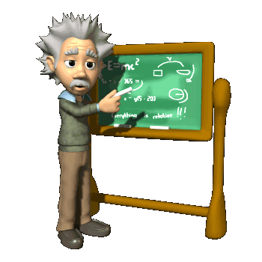
Chapter 0
Preliminaries (预备知识)
In this Chapter, we will know some important concepts.
Polynomials and Rational Functions
Inverse Functions
Trigonometric and Inverse Trigonometric Functions

Slide 16
Section 0.1 Polynomials（多项式） and Rational Functions （有理函数）
The Real Number (实数) System
Integers (整数)：0, ±1，±2，………
Rational numbers（有理数）: A rational number is any number of the form p/q, where p and q are integers and q≠0.
Irrational numbers are those real numbers that cannot be written in the form p/q, where p and q are integers. Irrational numbers have decimal expansions that do not repeat or terminate.

Slide 17
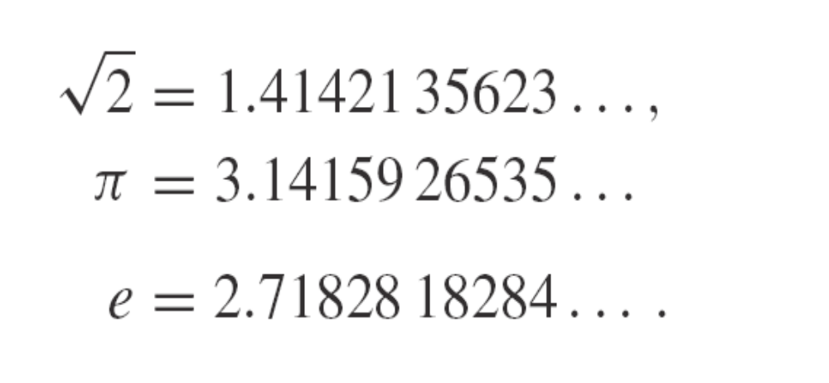

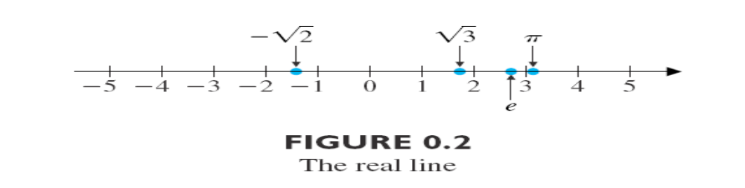
For instance, three familiar irrational numbers and their decimal expansions are
We picture the real numbers arranged along the number line displayed in Figure 0.2 (the real line). The set of real numbers is denoted by the symbol

Slide 18


Prove that is an irrational number
If we only stay within the range of rational numbers, then it is already obvious in geometry that not all line segments can have a length. For example, the length of the diagonal of a square.
Exercises
Show that is an irrational number

Slide 19
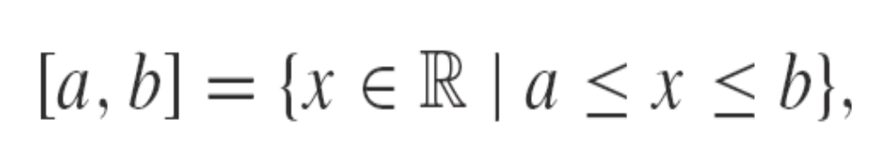
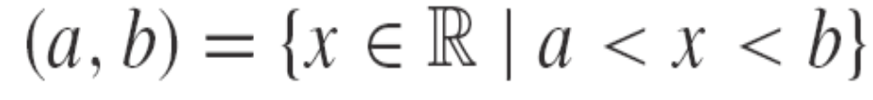
The intervals
The closed interval (闭区间) [a,b] to be the set of numbers between a and b, including a and b (the endpoints), that is,
The open interval (a,b) is the set of numbers between a and b, but not including the endpoints, that is

Slide 20
Addition and subtraction of real numbers (实数的加法及减法)
II-1: a+b=b+a (commutative law of addition 交换律)
II-2: (a+b)+c=a+(b+c) (associative law 结合律)
II-3: a+0=a (property of zero number)
II-4: For any number a, there exists a number –a such that a+(-a)=0.
II-5: From a>b, we have a+c>b+c.

Slide 21
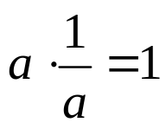
Multiplication and division of real numbers (实数的乘法及除法)
III-1: ab=ba (commutative law)
III-2: (ab)c=a(bc) (associative law)
III-3: a·1=a (property of 1)
III-4: For any number a≠0, there exists its
reciprocal number 1/a such that
III-5: (a+b)c=ac+bc (distributive law 分配律 )
III-6: From a>b and c>0, we have a·c>b·c

Slide 22


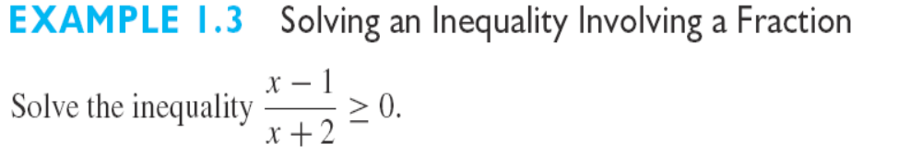
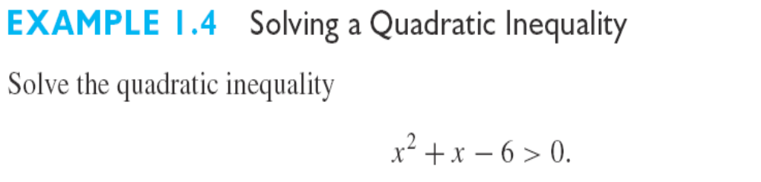

Slide 23
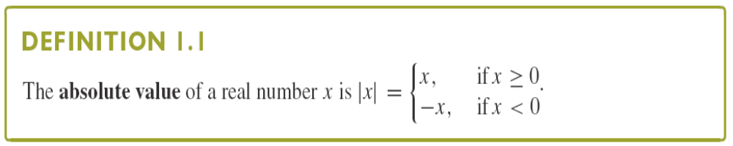
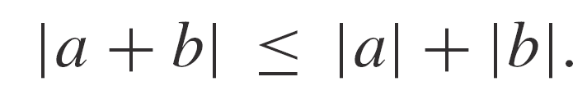
Triangle inequality (三角不等式)

Slide 24
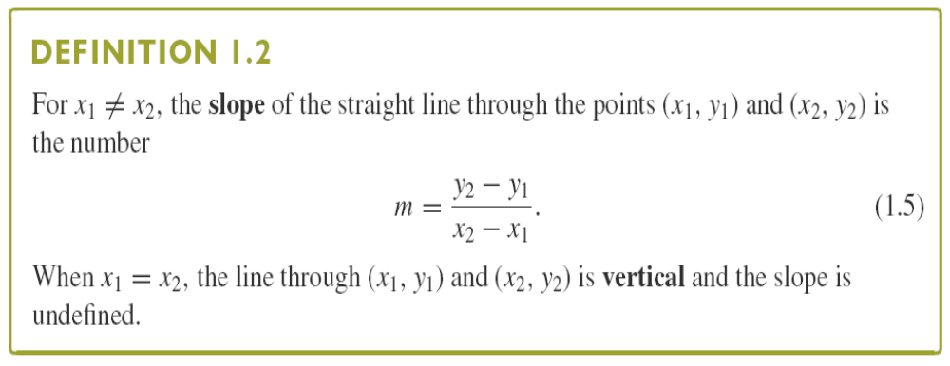
Equations of Lines (直线方程)
Notice that a line is horizontal if and only if its slope is zero.

Slide 25
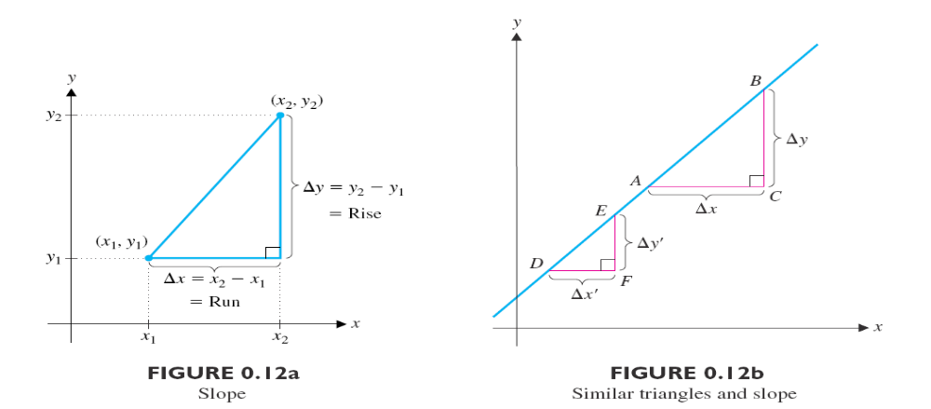
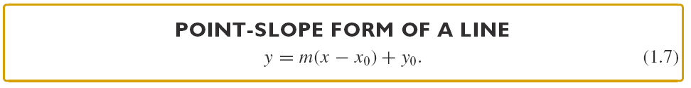
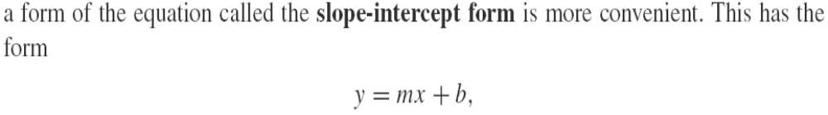

Slide 26
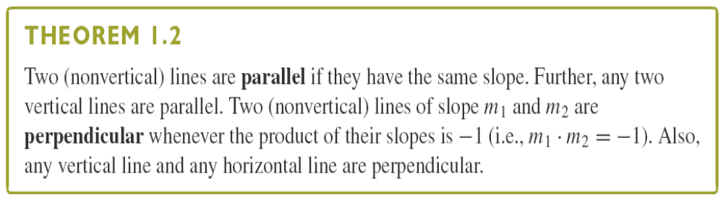
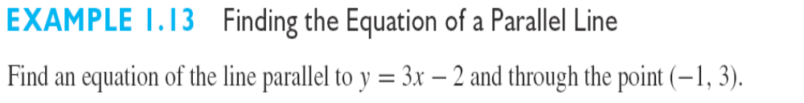
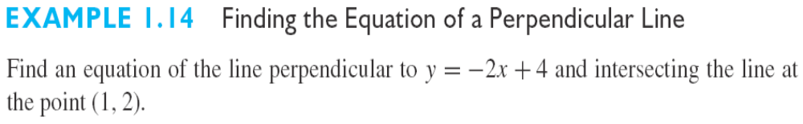

Slide 27
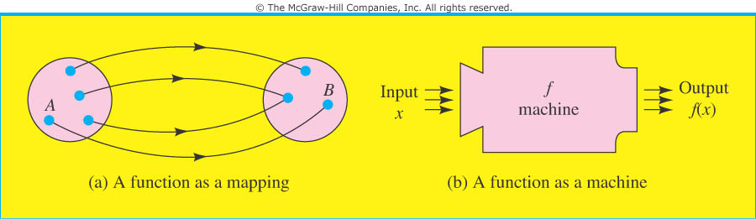
Functions（函数）
A function f is a rule that assigns to each object in a set A exactly one object in a set B. In this case, we write y=f(x).
The set A is called the domain (定义域) of the function, and the set of assigned objects in B is called the range （值域）. We refer to x as the independent variable （自变量）and to y as the dependent variable（因变量）.

Slide 28
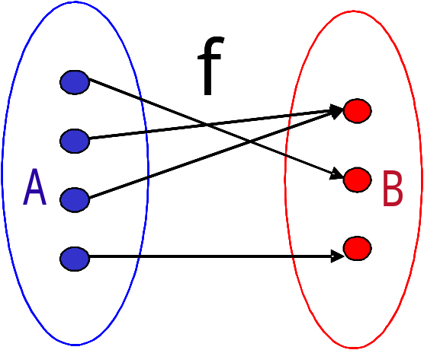
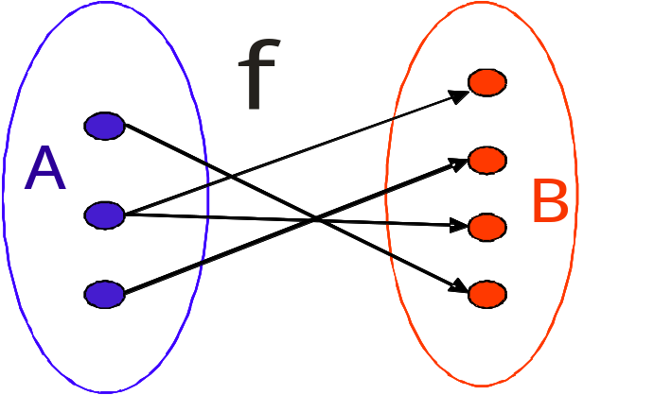
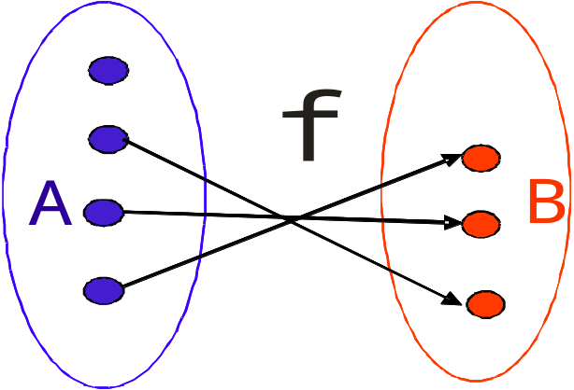
Function, or not?
YES
NO
NO

Slide 29
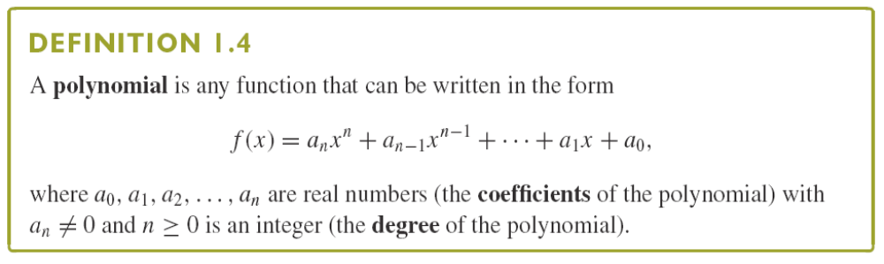
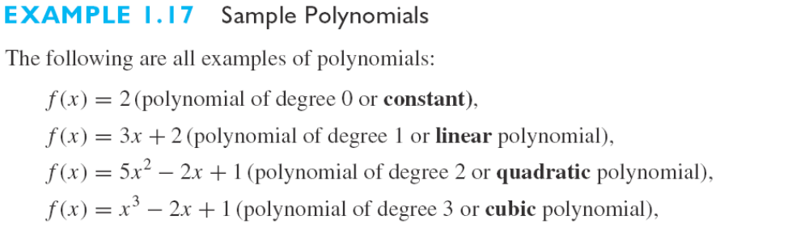

Slide 30
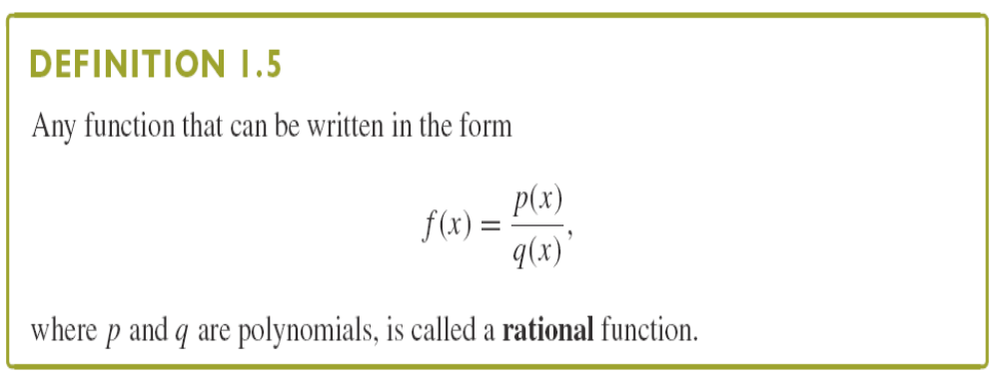
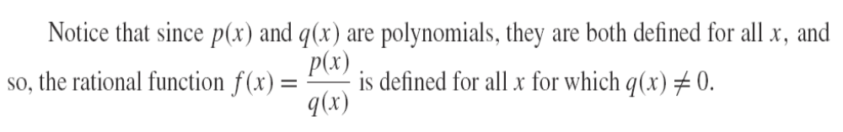
Rational Function (有理函数)

Slide 31
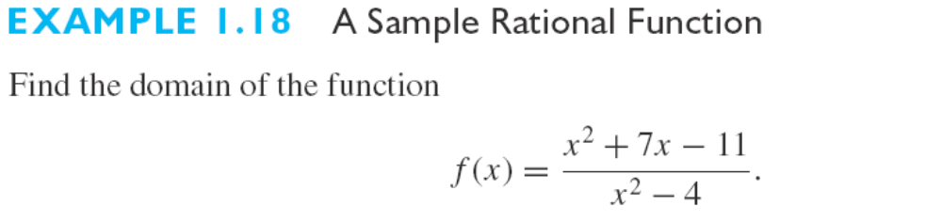
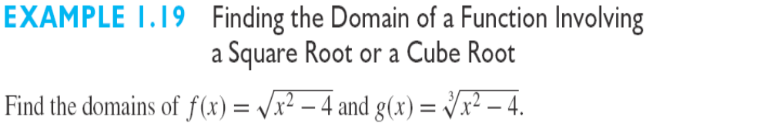
In general, there are two situations where a number
is not in the domain of a function:
1) division by 0
2) The even number root of a negative number

Slide 32
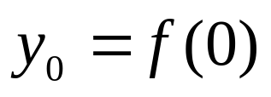
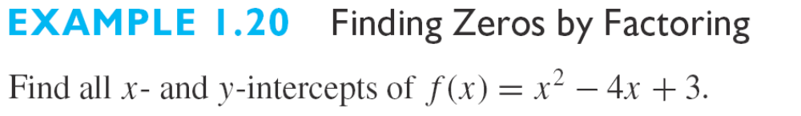
Intercepts
x intercepts: The points where a graph crosses the x axis.
A y intercept: A point where the graph crosses the y axis.
How to find the x and y intercepts: The only possible y intercept for a function is , to find any x intercept of y=f(x), set y=0 and solve for x.
Note: Sometimes finding x intercepts may be difficult.

Slide 33
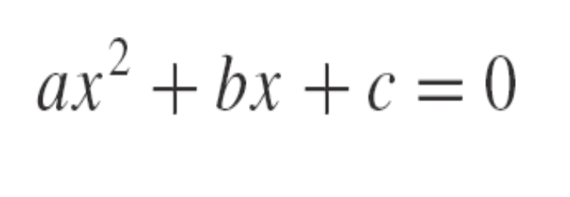
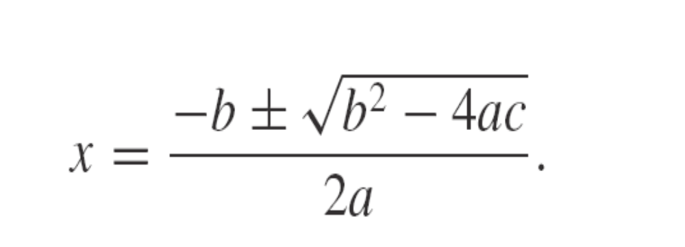
Unfortunately, factoring is not always so easy. Of course, for the quadratic equation
(for a≠0), the solutions are given by the familiar quadratic formula:

Slide 34
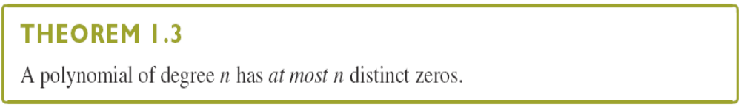
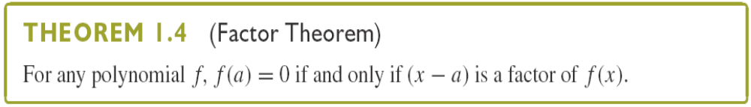
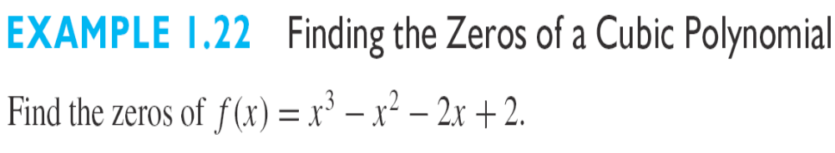

Slide 35


Section 0.3 Inverse Functions (反函数)
Composition of Functions（复合函数）: Given functions f(u) and g(x), the composition f(g(x)) is the function of x formed by substituting u=g(x) for u in the formula for f(u).
Example
Find the composition function f(g(x)), where and
Solution:
Replace u by x+1 in the formula for f(u) to get
Question: How about g(f(x))?
Note: In general, f(g(x)) and g(f(x)) will not be the same.

Slide 36
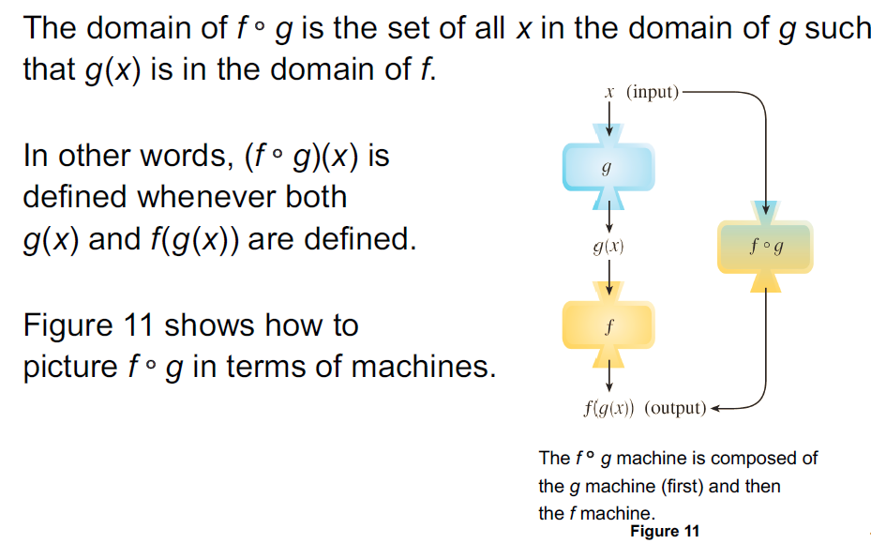

Slide 37
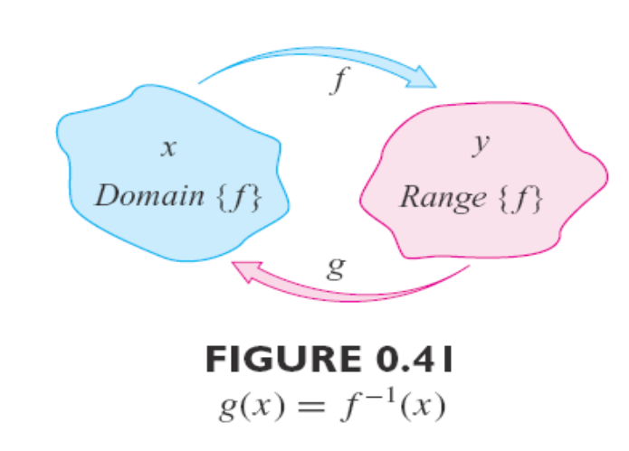
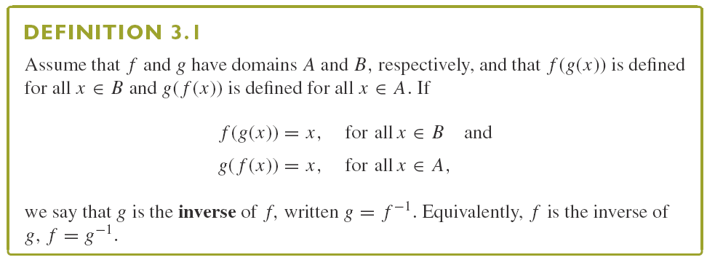
Inverse Functions

Slide 38
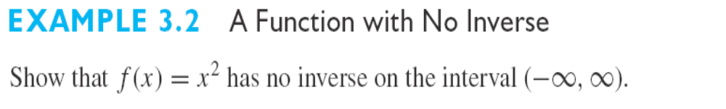
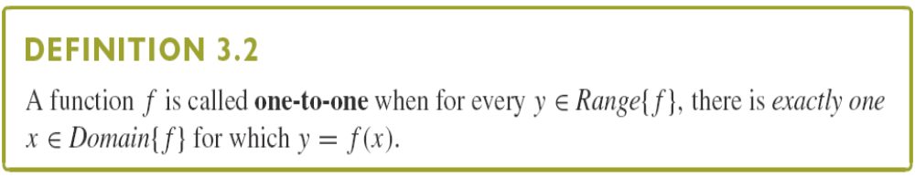
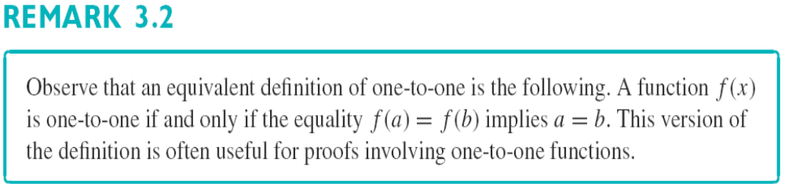

Slide 39
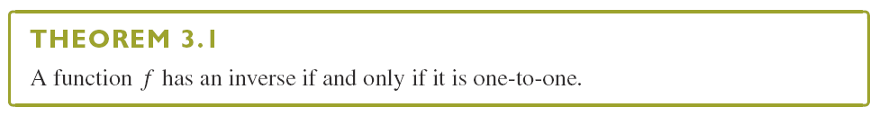
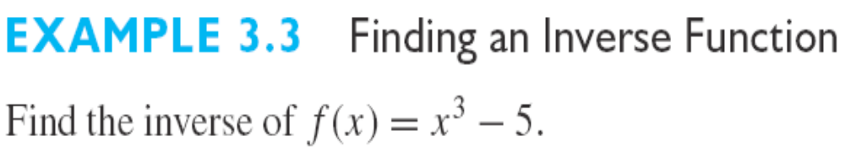
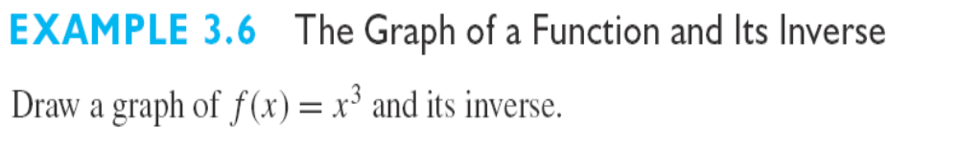

Slide 40
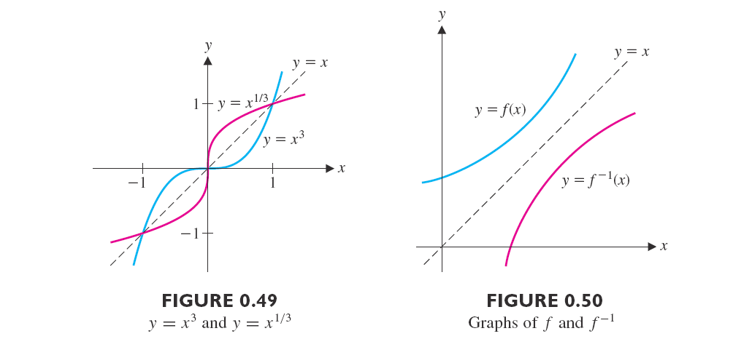

Slide 41
Section 0.4 Trigonometric (三角函数) and Inverse Trigonometric Functions (反三角函数)
Many phenomena encountered in your daily life involve waves.
Radar Signals
Electromagnetic waves
Electrocardiogram
The mathematical description of such phenomena involves periodic functions, the most familiar of which are the trigonometric functions.

Slide 42
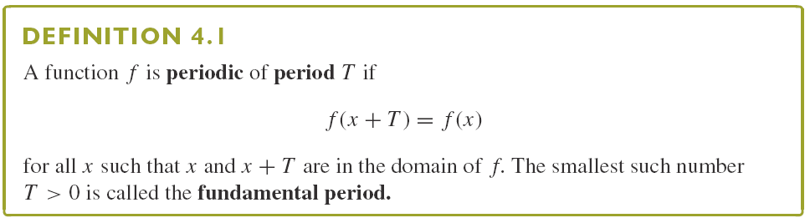

Remark: When we discuss the period of a function, we most often focus on the fundamental period.

Slide 43


Slide 44







Slide 45



The Inverse Trigonometric Functions

Slide 46





Slide 47

Section 0.5 Symmetry (Odd/Even) Functions (奇偶函数)

Slide 48



Slide 49


Example 5.1

Slide 50

Exercise Question:
Show that any function defined on can be expressed as the sum of an even function and an odd function.

